Slide 1
Horse-Racing Tipster Bets
A Data Mining Project Analysis

Slide 2
The Problem and Motivation
The traditional approach in attempting to make a profit from horse-racing, using machine learning techniques, is to use systems involving dozens and dozens of variables.
Finding, compiling, maintaining, and updating this data is a massive task for the individual. Unless you have access to a database of such data - where would you even start?
We use the tipsters’ predictions and run them through a machine learning algorithm (Microsoft Azure) assuming it to predict a 'win' or 'lose' based upon the tipster’s performance history.

Slide 3
Knowing the Data
Tipster
Track
Horse
Bet Type
Odds
Result
Tipster Active
Challenge
Challenge 3

Slide 4
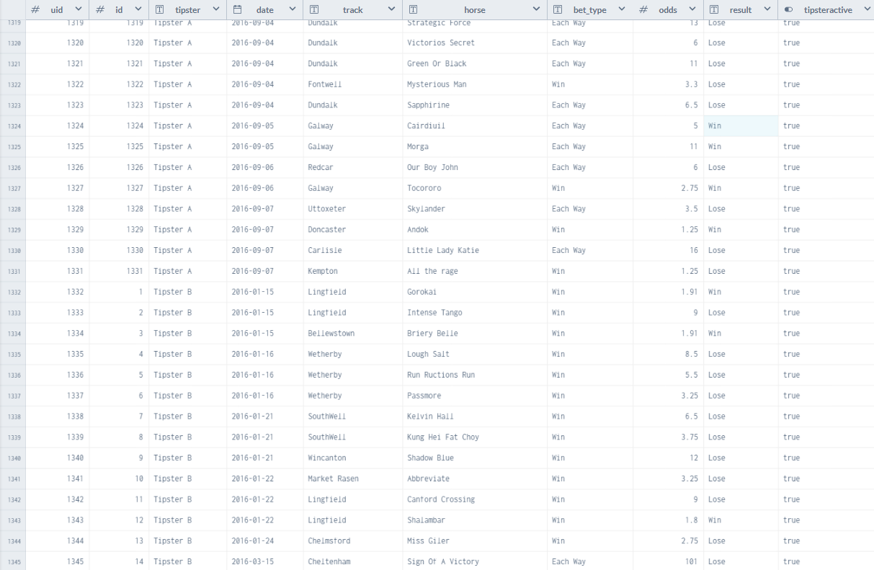

Slide 5
Predictive Model

Slide 6
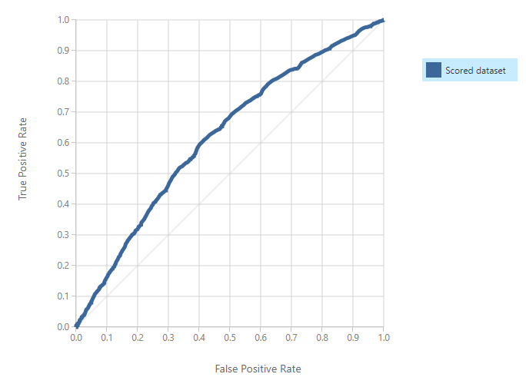
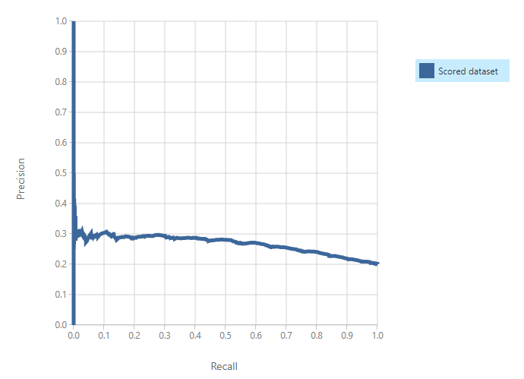
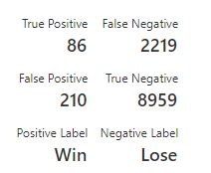
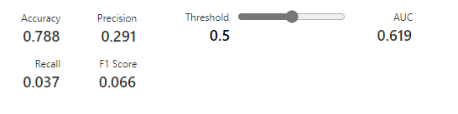
1. Two Class Support Vector Machine

Slide 7
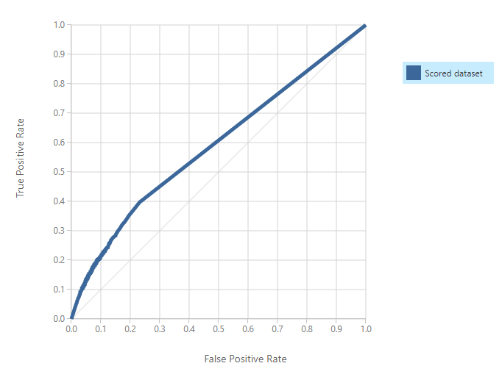
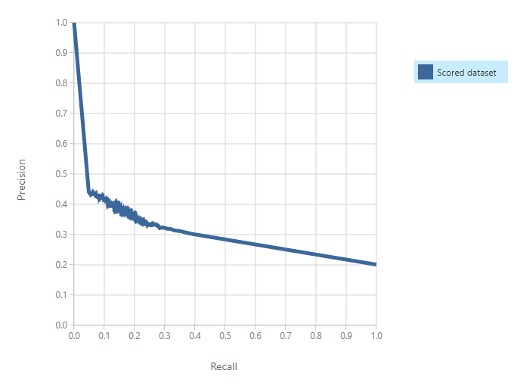
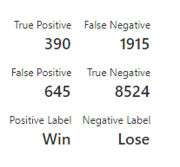
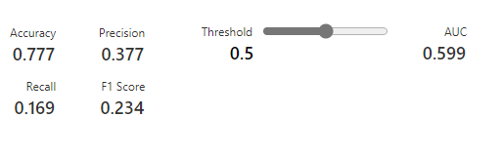
1. Two Class Neural Network

Slide 8
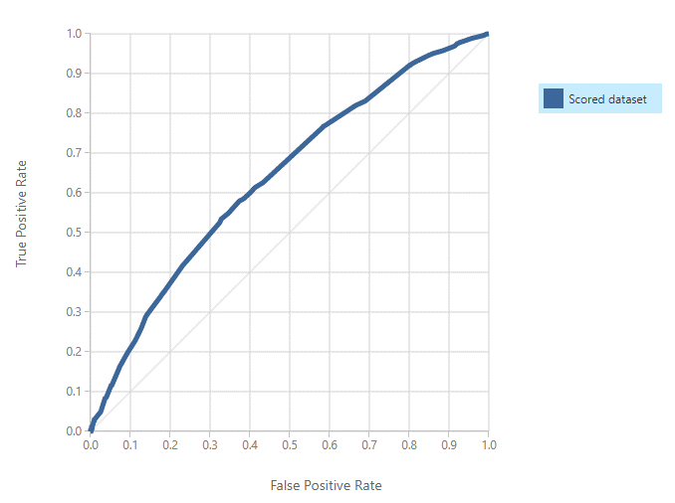
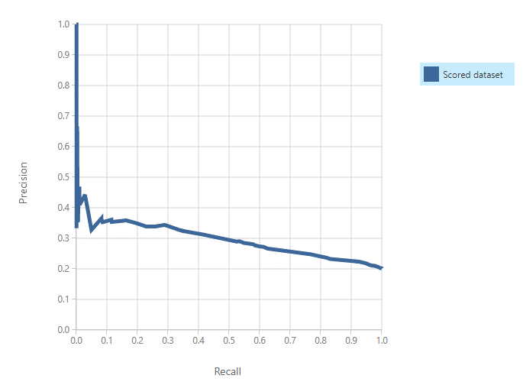
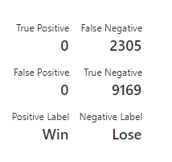
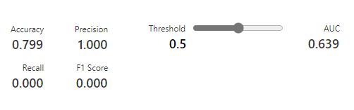
1. Two Class Decision Jungle

Slide 9
Conclusion &
Additional optimization efforts should be made in order to attain a higher score and, as a result, boost prediction power and hence increase user profits
Create a plan for retaining tipsters.
Using data from additional horse-racing betting sources, apply survival analysis techniques to estimate profits.
max growth
Recommendations

